Slide 1
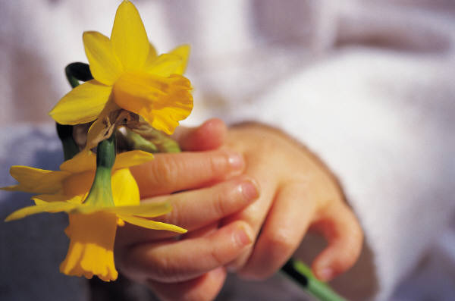
Learning Unit:
What’s Sprouting in Spring?
Life Science
Teachers: Megan Mundie and Tanya Jackson
Spring 2012

Slide 2
Why Teach Science?
It’s importance is shared by many but , Nancy Atkinson explained it well in this following statement.
“Science is everywhere in today’s world. It is part of our daily lives, from cooking and gardening, to recycling and comprehending the daily weather report, to reading a map and using a computer. Advances in technology and science are transforming our world at an incredible pace, and our children’s future will surely be filled with leaps in technology we can only imagine. Being “science literate” will no longer be just an advantage but an absolute necessity. We can’t escape from the significance of science in our world. But not everyone understands that, or has been taught to think critically, or been provided with the tools to analyze and test a problem or situation.”
http://vimeo.com/3531977 www.universetoday.com/83736/importance-of-science

Slide 3
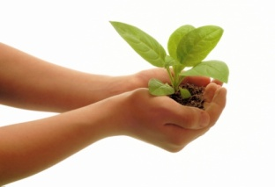
Content Standards:
Standard 3.0 Life Science: The students will use scientific skills and processes to explain the dynamic nature of living things, their interactions, and the results from the interactions that occur over time.
A. Diversity of Life
1. Observe a variety of familiar plants and animals to describe how they are alike and how they are different.
a. Gather information about how some animals are alike in the way they look and in the things they do.
b. Gather information about how some plants are alike in the way they look and in the things they do.
c. Draw a picture of two animals that look alike (or plants) and of two animals (or plants) that look different and respond to questions that are raised by those who observe the pictures.

Slide 4

Content Standards continued:
d. Identify some of the things that all animals do, such as eat, move around and explain how their features (observable parts) help them do these things.
C. Genetics
1. Observe, describe and compare different kinds of animals and their offspring.
a. Recognize and describe the similarities and differences among familiar animals and their offspring.
b. Describe how offspring are very much, but not exactly, like their parents and like one another.
Standard 1.0 Skills and Processes
A. Constructing Knowledge
1. Students will demonstrate the thinking and acting inherent in the practice of science.
a. Describe what can be learned about things by just observing those things carefully and adding information by sometimes doing something to the things and noting what happens.
b. Seek information through reading, observation, exploration, and investigations.
C. Use tools such as thermometers, magnifiers, rulers, or balances to extend their senses and gather data.

Slide 5
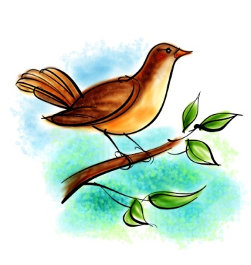
BT1: Emotional Connection
Have an opportunity to choose seeds and grow a plant
Take photographs during Spring walk and bring things from the outside environment into the room
Show their knowledge of the different parts of animals flowers and insects by creating anatomically correct snacks
    Discuss their favorite parts of Spring

Slide 6
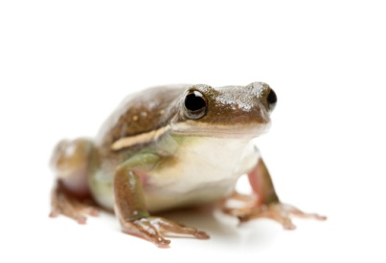
BT 2: Physical Environment
Take a Spring Walk and use elements we find outside to make and display a Spring Collage
Plant flowers and keep them displayed in our rooms for the children to observe
Add Spring books to our classroom libraries
Decorate the room with student art work (butterflies, bees and flowers)
Keep observation jars available for insects we find
Keep a caterpillar habitat so the students can watch them transform into butterflies
Decorate: Transform room with student generated artifacts representing theme.
Collect and bring in different flowers for students to smell

Slide 7
BT 3: Concept Mapping
Life
Cycle
Body
Parts
Habitat
Needs
Plants
Animals
Insects
SPRING

Slide 8
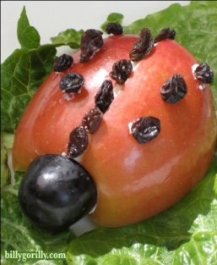
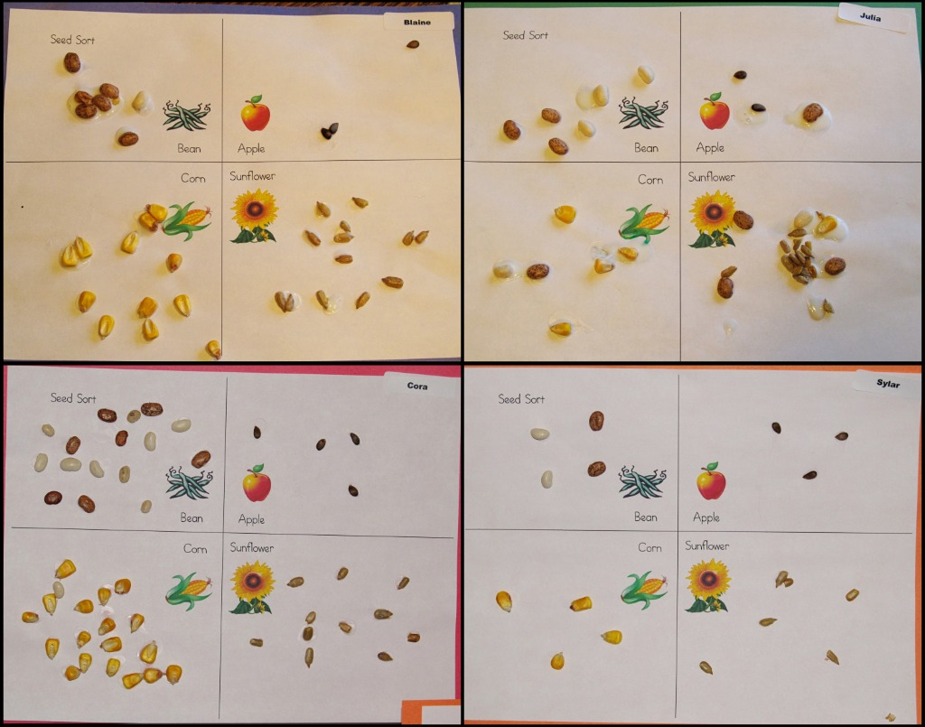
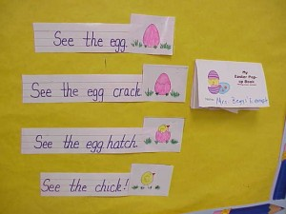
BT 4: Activities for Declarative/
Procedural Knowledge
Read and discuss Spring literature
Collaborative and independent writing about Spring
Creating anatomically correct bug and flower snacks
Compare and contrast diagrams for needs of animals/plants/insects
Math projects to measure, count, compare types of plants being grown and how they grow similarly/differently
                Counting and sorting different types of seeds Scientific drawing and labeling of plants/animals/insects

Slide 9
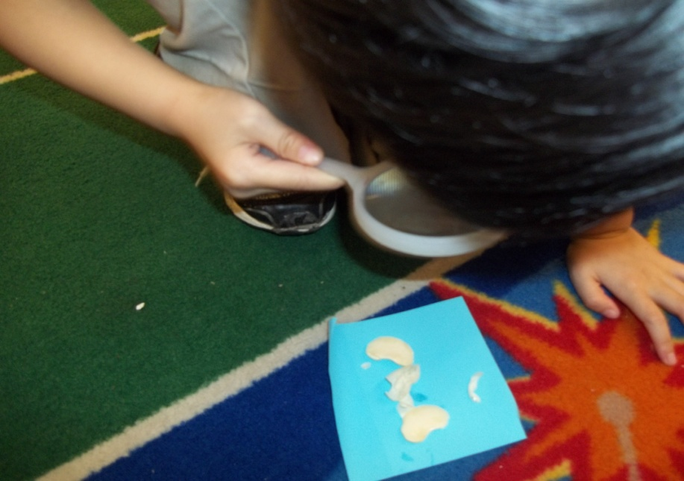
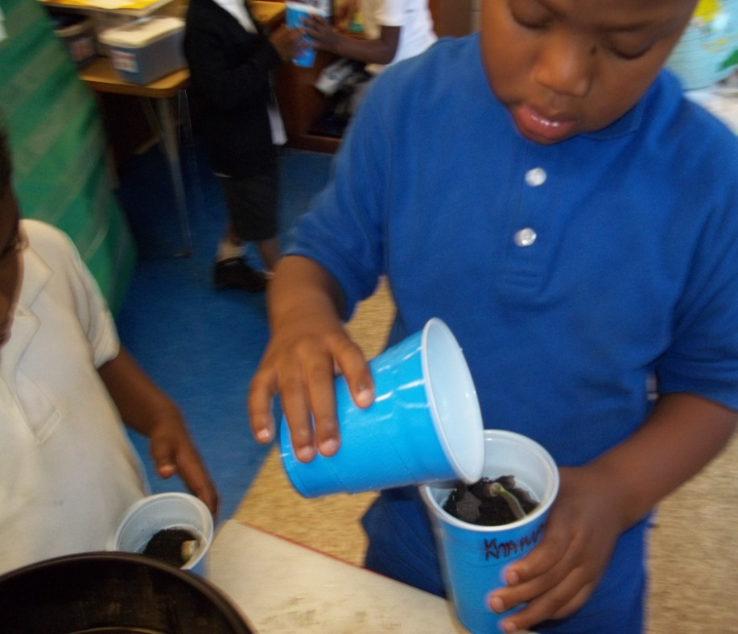

Slide 10
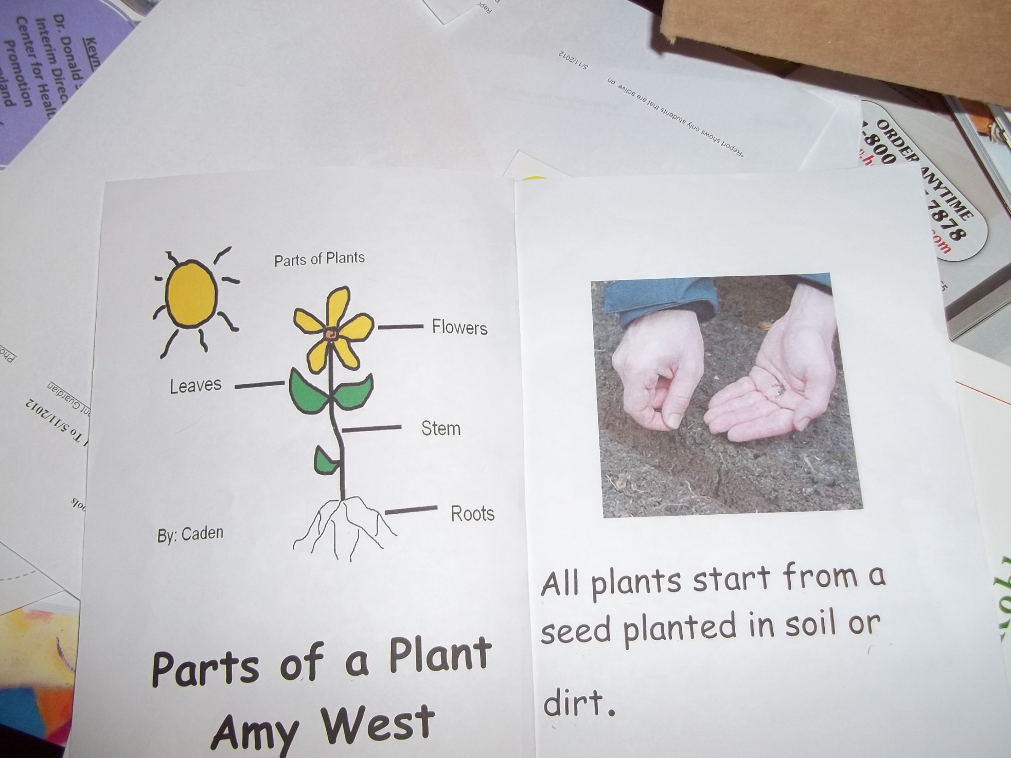

Slide 11
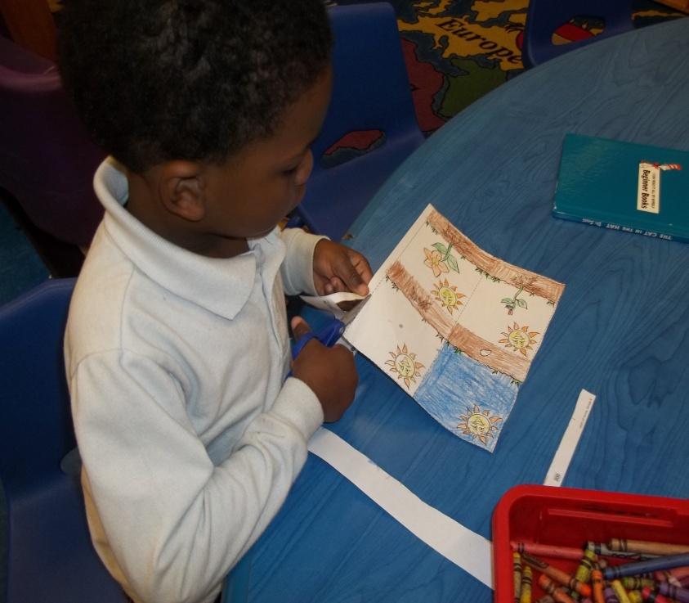
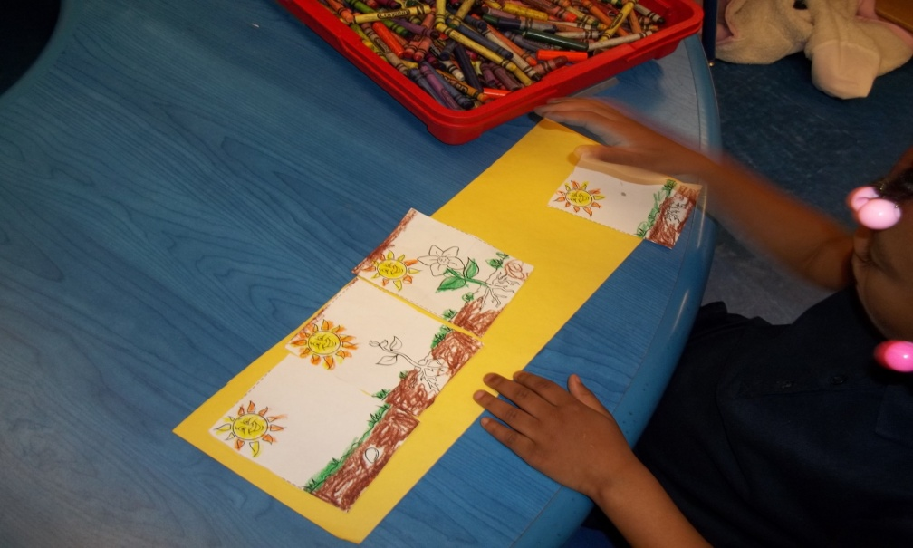
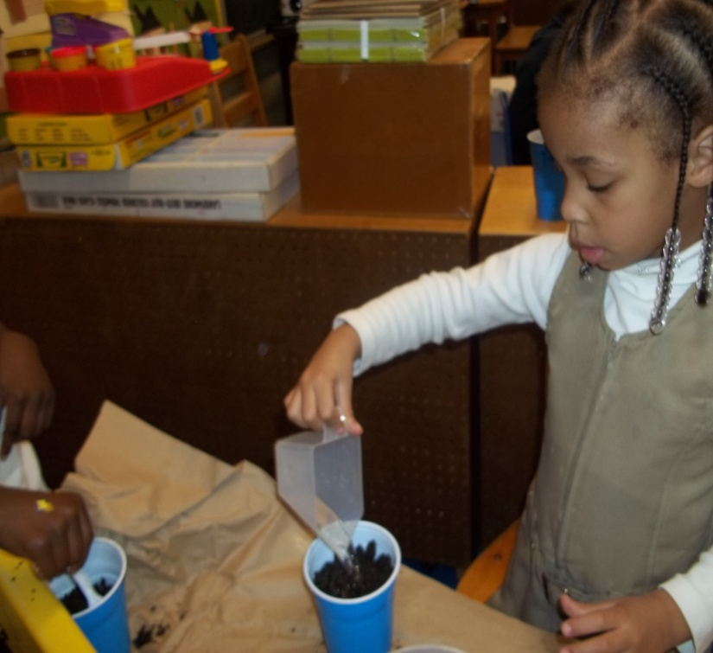
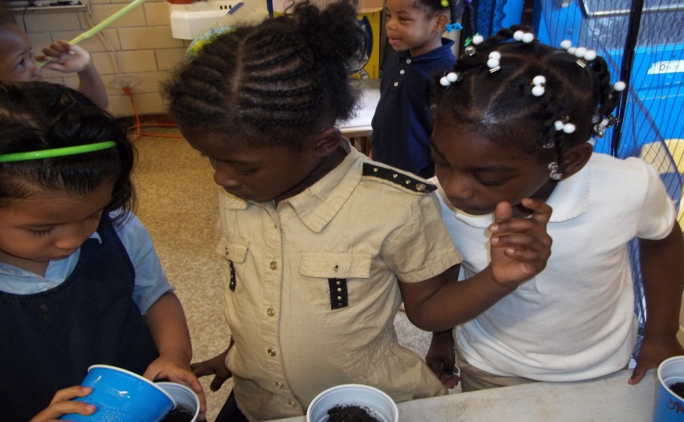

Slide 12
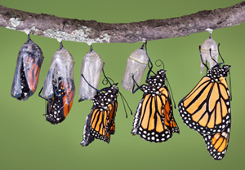
BT 5: Activities for Application and Extension of Knowledge
Spring walks to take photographs and collect specimens to create a collage
Plant flowers, monitor their growth and observe their needs
Observe and monitor caterpillars turning into butterflies
Field Trips

Slide 13
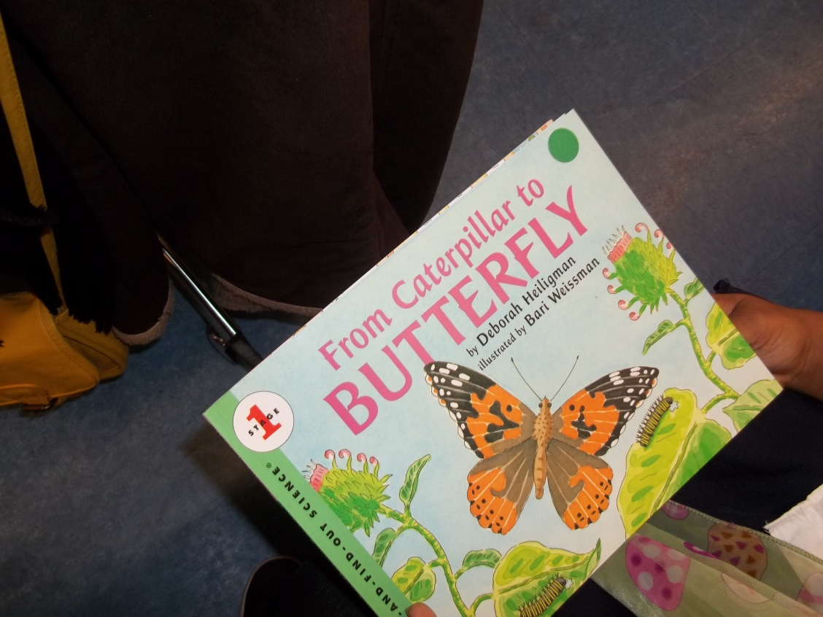
Non- Fiction Literature
Were Learning about the Life Cycle of a Butterfly

Slide 14
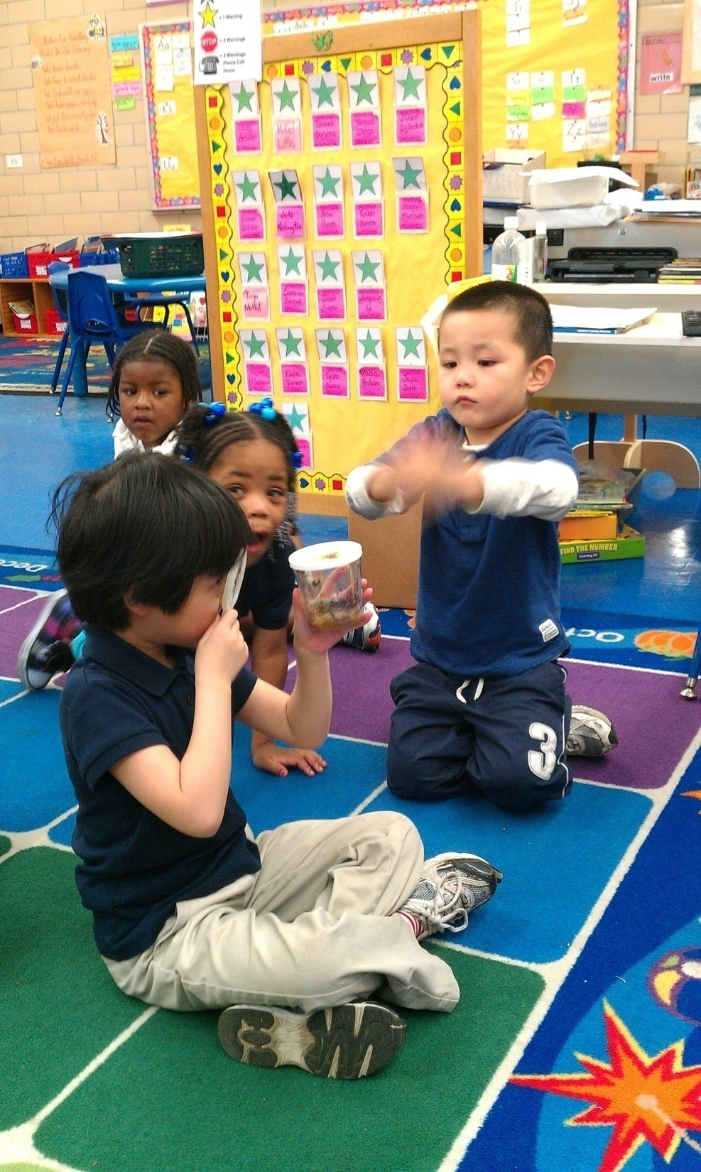

Slide 15
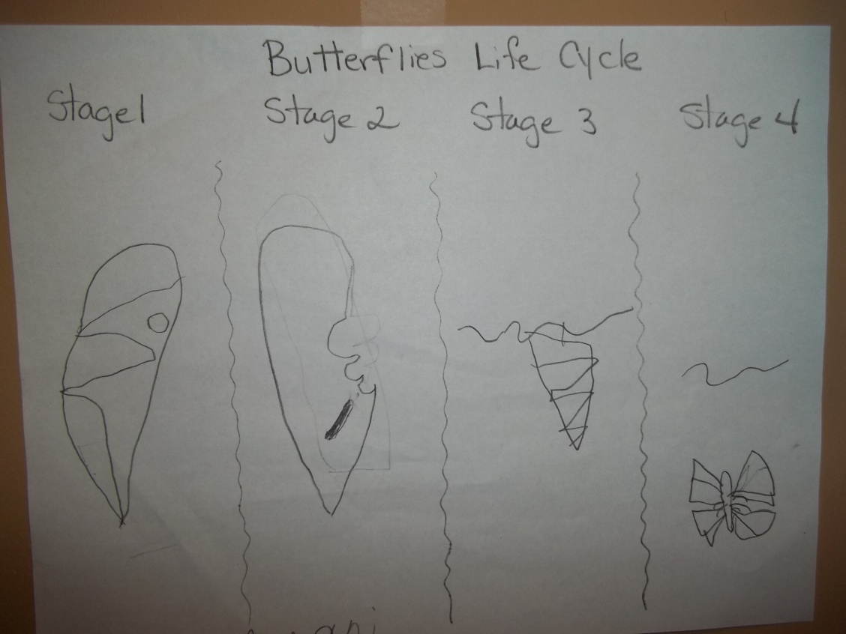
Application of knowledge
Illustration of Life Cycle of Butterfly.

Slide 16
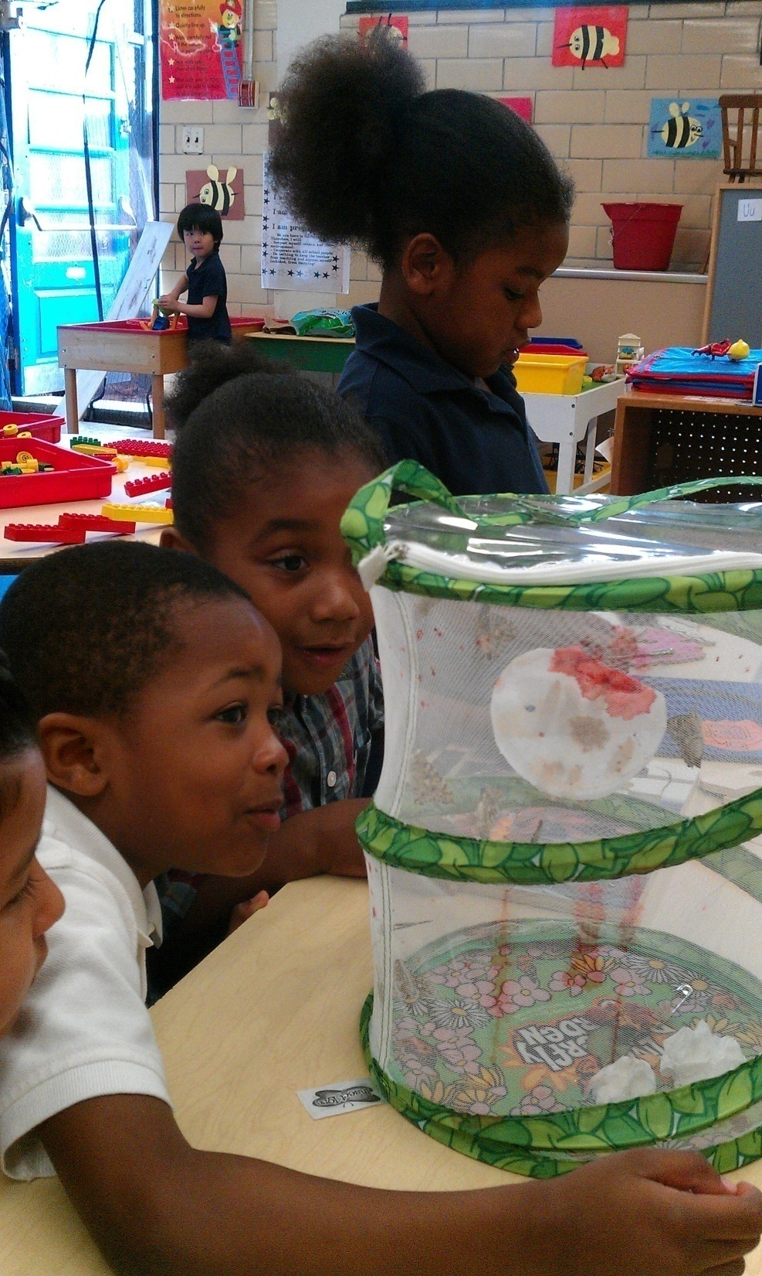

Slide 17
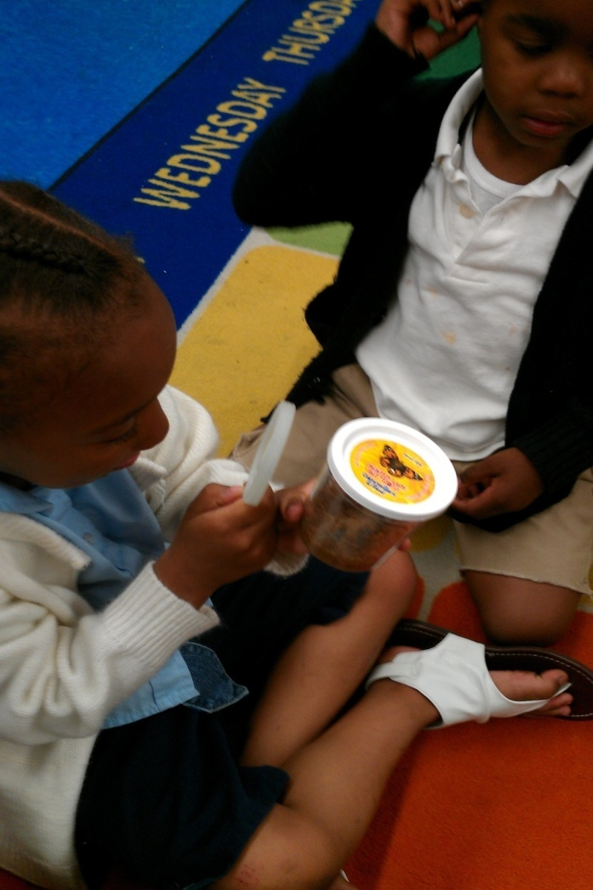
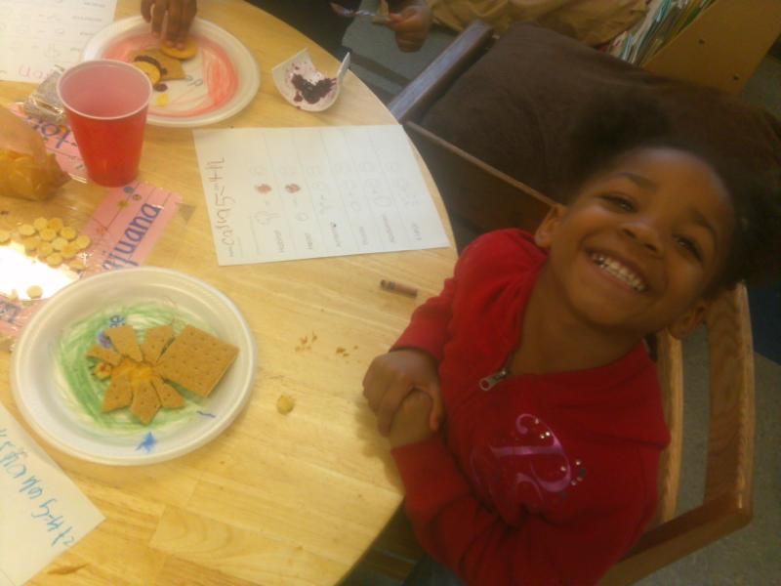
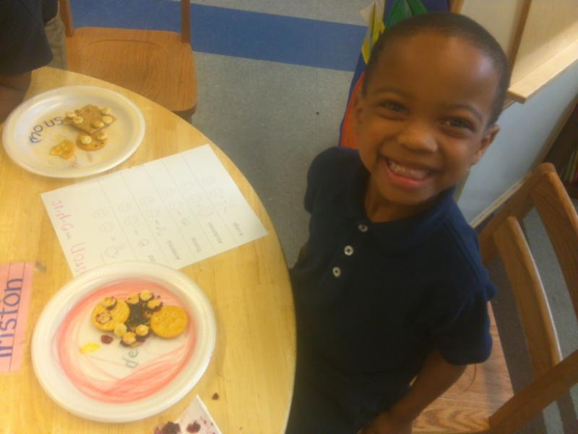

Slide 18
BT 6: Evaluating Learning
Rubric’s for both teacher and student in evaluation of snack projects and scientific drawings
Anecdotal notes and student teacher conversation and questions to monitor progress during entire unit
Observation charts for students to monitor growth and needs of flower and insects ( butterflies and ladybugs)

Slide 19
